Slide 1

Lab 12: VHDL
CSE 2301 – Fall 2024

Slide 2
Introduction: overview
Today’s Lab will include a lecture and an assignment
You will be learning the basics of VHDL and re-creating two previous labs in VHDL, the 2 Bit ALU and the Hamming Code Generator
Contrast the difficulty of these labs with how easily they are implemented in VHDL
You will be given significant starter code

Slide 3
VHDL : VHSIC Hardware Description Language
Specialized language for designing and simulating hardware systems
Used in domains of PLA programming, PCB design, and integrated circuit design
Design paradigms for both combinational and sequential circuits

Slide 4
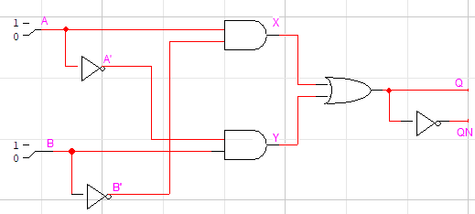
Combinational Design
Consider the following combinational circuit
The equations for the outputs are: Q = AB’ + A’B QN = (AB’ + A’B)’ = Q’

Slide 5
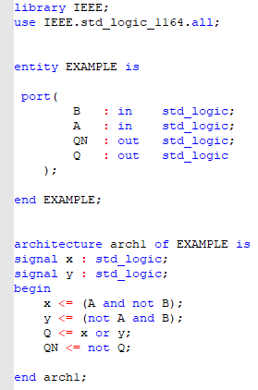
Combinational VHDL

Slide 6
Combinational VHDL: Assignment (the important slide)
Focus on the red boxed section of code
The symbol <= is for assignment; The signal on the left will be set to the expression on the right.
In VHDL, there is no concept of order, the first statement won’t always execute before the last.
Instead, all signals are updated constantly and concurrently
When input A is changed, the value of X and Q are updated simultaneously, in any order

Slide 7
Combinational VHDL: Assignment
Valid keywords include:
Logical: and, or, not, nand, nor, xor, xnor
Arithmetic: +, -, *, /, **
Shift: sll, srl, sla, sra
Concatenation: & ex: “01” & “10” returns “0110”
To assign a literal to a…
Signal: use single quotes e.g. x <= ‘1’
Vector: use double quotes e.g. x <= “0011”

Slide 8
Combinational VHDL: Library
Libraries give us access to additional functions
std_logic_1164 contains std_logic and std_logic_vector and related functions
IEEE.numeric_std.all allows us to use arithmetic operators

Slide 9
Combinational VHDL: Entity
You will not be responsible for this part of the program
Defines the input and output interface of the part
std_logic represents a 1 bit signal, which can be ‘0’ or ‘1’
std_logic_vector represents a multi-bit signal of any length like “01” or “0001100001111111”

Slide 10
Combinational VHDL: ARCHITECTURE
You will not be responsible for most of this part of the program
Before the “begin” keyword, extra signals are defined
These are internal signals which are not inputs or outputs
After the “begin” keyword, the behavior of the part is defined
Again, the order of signals does not matter, and the statements will continuously execute forever

Slide 11
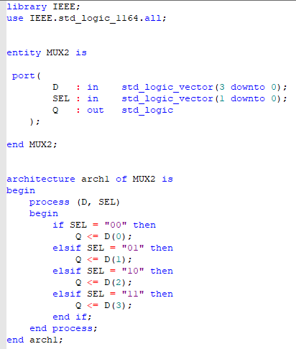
Combinational VHDL: MUX example
This VHDL program implements a 4:1 MUX

Slide 12
Combinational VHDL: MUX entity
This VHDL program implements a 4:1 MUX
The entity portion defines 2 inputs and 1 outputs
D is a 4 bit input; SEL is a 2 bit input; Q is a 1 bit output
Single bits from vectors can be accessed with parenthesis
The rightmost bit of D is D(0); the leftmost bit is D(3)

Slide 13
Combinational VHDL: Processes
This VHDL program implements a 4:1 MUX
Processes are like functions
The signals in parenthesis after process are the Sensitivity List
The process will run whenever one of the signals in the sensitivity list changes
If statements may only be used inside processes

Slide 14
Combinational VHDL: Processes
This VHDL program implements a 4:1 MUX
Processes are sequential… kind of
Take for example: process (y) begin x <= ‘1’; y <= ‘x’; end process;
If x has a value of 0 when the process begins executing, the value of y after the function finishes is 0, not 1.
Fix this by adding x to the sensitivity list of the process so that the process will execute twice

Slide 15
Combinational VHDL: Extra Notes
Signal lengths need to match
Take for example
If Q is a 4 bit signal, and A and B are 2 bit signals, A and B need to be padded to be 4 bits using extra 0s. This is accomplished using the concatenation operator.
In order to use the arithmetic operators, A and B need to be converted to unsigned integers. Use the unsigned function to convert bit vectors to unsigned integers.

Slide 16
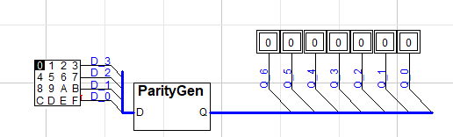
Part 1: PARITY bit generator
Parity Bit | Based on Data Bits
P1 | D(3), D(2), D(0)
P2 | D(3), D(1), D(0)
P3 | D(2), D(1), D(0)
We will be implementing an even parity bit generator

Slide 17
REVIEW: hamming code
Bit positions
Q(6)
Q(5)
Q(4)
Q(3)
Q(2)
Q(1)
Q(0)
Hamming codes add parity bits for error checking. With the hamming distance seen here (3), we can check for and correct one error.
Note the names we give the parity and data bits here. They represent weights.
Weighted 4-bit data word
D(3)
D(2)
D(1)
D(0)
Parity bit positions - interspersed
P1
P2
P4

Slide 18
Part 1: PARITY BIT generator
3 data bits |  |  | Even parity bit
X | Y | Z | P
0 | 0 | 0 | 0
0 | 0 | 1 | 1
0 | 1 | 0 | 1
0 | 1 | 1 | 0
1 | 0 | 0 | 1
1 | 0 | 1 | 0
1 | 1 | 0 | 0
1 | 1 | 1 | 1
The truth table shows how you might reduce the equation to determine the output of each parity bit based on three inputs (as described on the previous page).
This seems overly complicated, doesn’t it?
P = X’Y’Z + X’YZ’ + XY’Z’ + XYZ

Slide 19
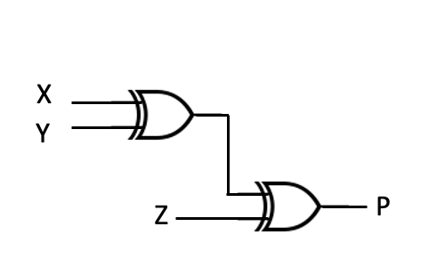




Part 1: PARITY bit generator
P = X’(Y’Z + YZ’) + X(Y’Z’ + YZ)
= X’(Y Z) + X(Y Z)’
= X Y Z
$$⨁$$
$$⨁$$
Using some Boolean algebra, we can simplify this greatly. This leads to a lemma of sorts: the XOR of multiple variables will tell us whether their sum is even (0 if even, 1 if odd).
$$⨁$$
$$⨁$$

Slide 20
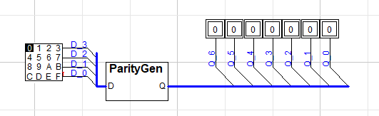

Slide 21
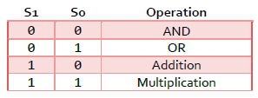
Part 2: BASIC ALU
Your task is to reimplement the ALU from lab 5 in VHDL. An Arithmetic Logic Unit performs different functions based on the provided selector input.
The ALU should be able to perform AND, OR, addition, and multiplication operations on two 2-bit binary inputs.
Do NOT implement these functions using logic gates, use the built in VHDL arithmetic operators

Slide 22
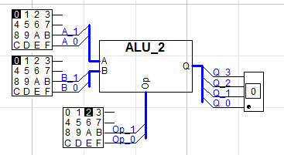

Slide 23
Starter Code
Starter code is provided for each file, you should only need to add code where indicated
None of this content was covered in lecture, so ask for help frequently

Slide 24
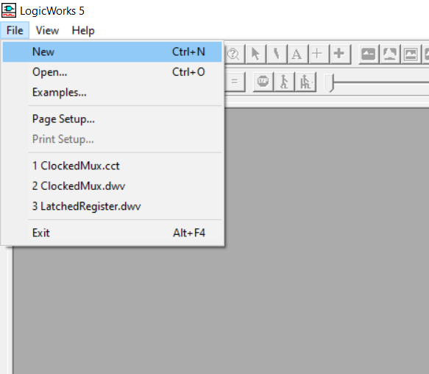
Follow Along
Click File->New

Slide 25
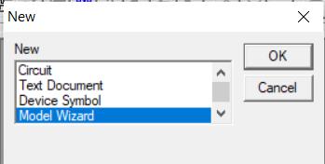
Follow Along
Click Model Wizard -> Ok

Slide 26
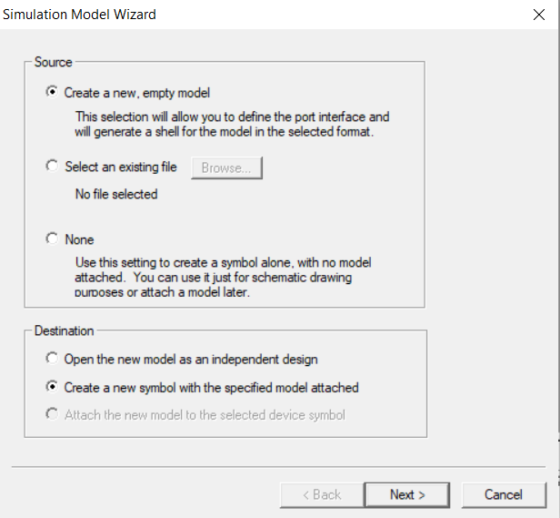
Follow Along
Click:
Create a new, empty model
Create a new symbol with the specified model attached
Next

Slide 27
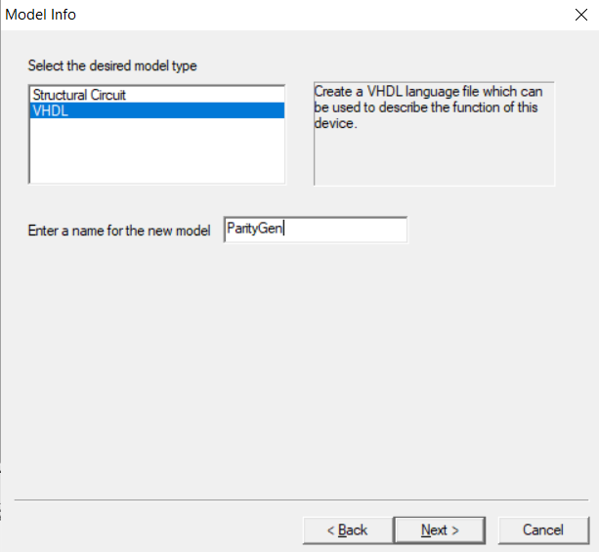
Follow Along
Click VHDL
Name the model
Click Next

Slide 28
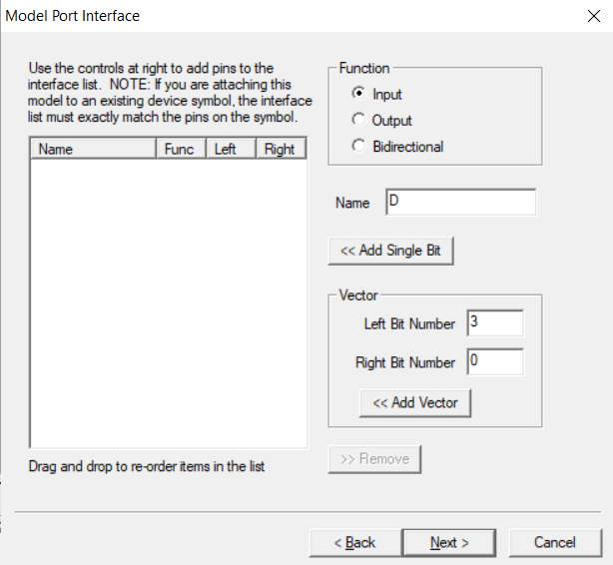
Follow Along
Create an input D with:
Function: Input
Name: D
Left Bit Number: 3
Right Bit number: 0
Click <<Add Vector; NOT <<Add Single Bit
Do not click next yet

Slide 29

Follow Along
Create an input D with:
Function: Output
Name: Q
Left Bit Number: 6
Right Bit number: 0
Click <<Add Vector; NOT <<Add Single Bit
Click Next

Slide 30
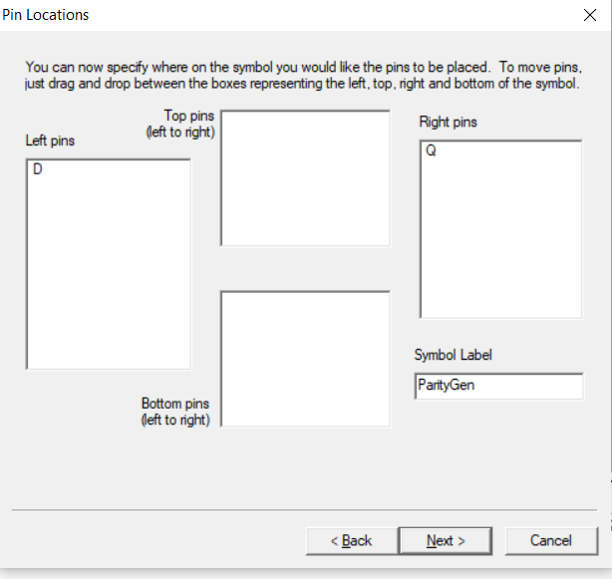
Follow Along
Ensure D is a left pin and Q is a right pin
Then click next

Slide 31
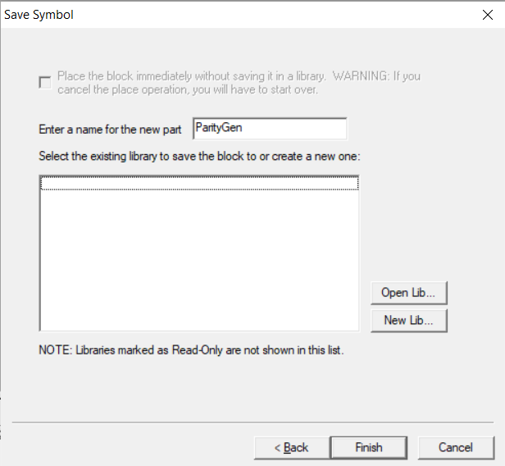
Follow Along
Click New Lib…

Slide 32
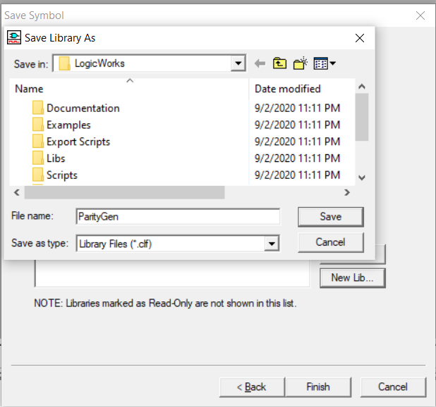
Follow Along
Name the library and click Save

Slide 33
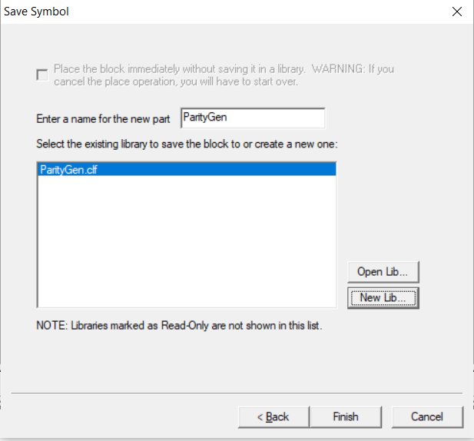
Follow Along
Select the new library and click Finish

Slide 34
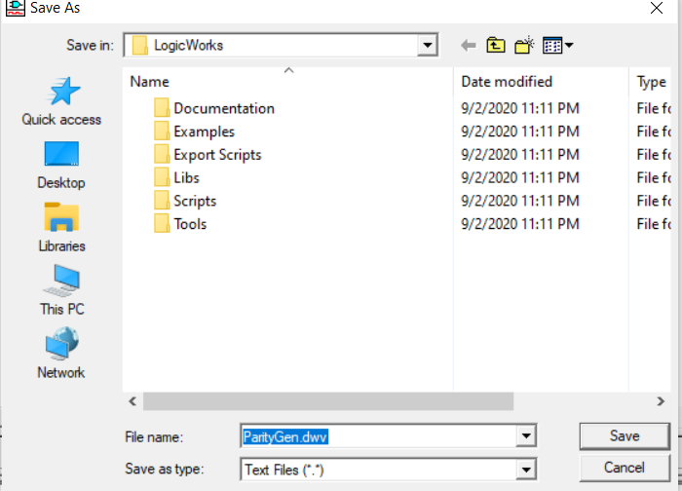
Follow Along
Save the VHDL file

Slide 35
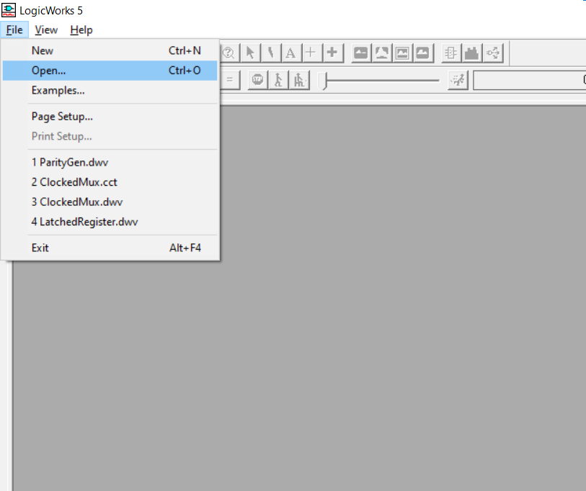
Follow Along
Click File -> Open

Slide 36
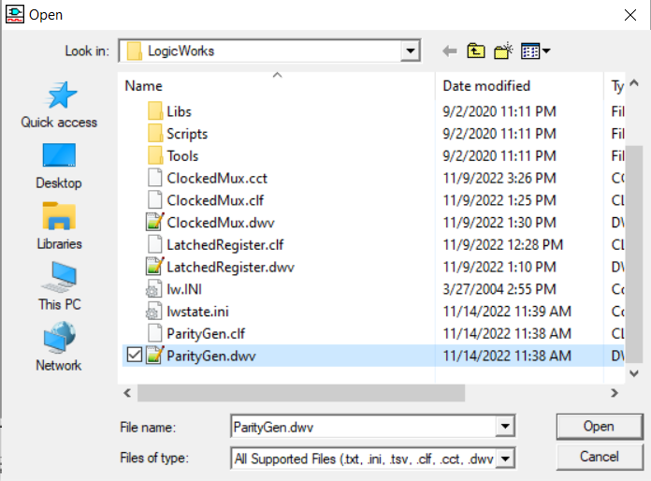
Follow Along
Select the dwv file you just saved, and click Open

Slide 37
Follow Along
Select the dwv file you just saved, and click Open

Slide 38
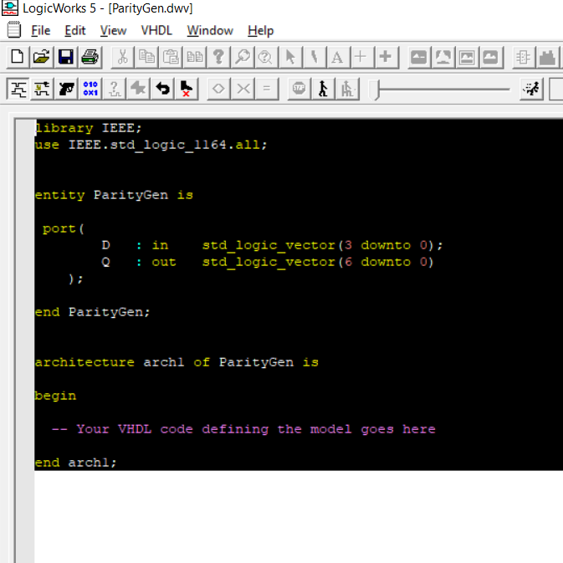
Follow Along
Delete everything currently in the file

Slide 39
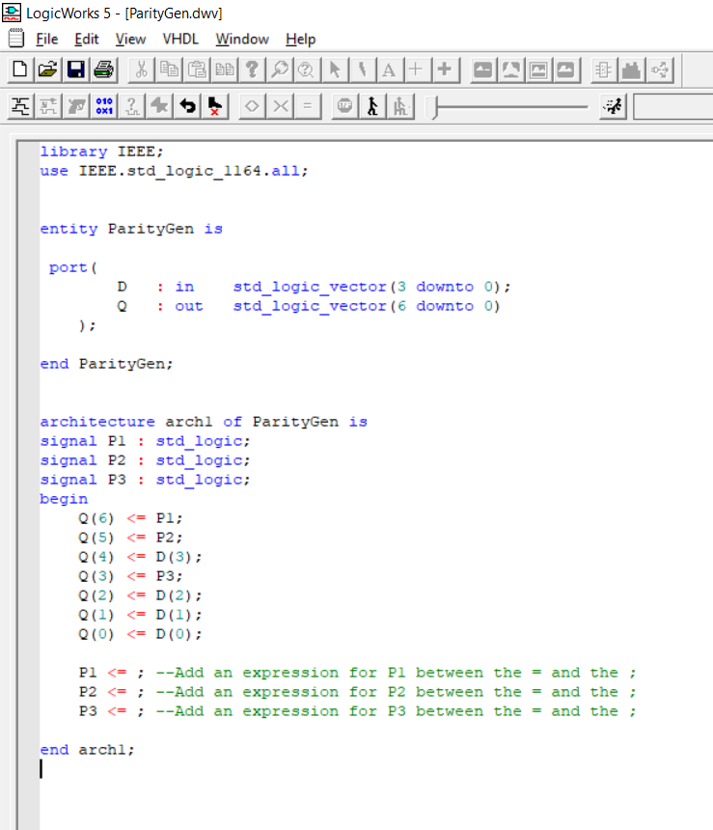
Follow Along
Paste in the starter code

Slide 40
Complete part 1
Add your code for P1 P2 and P3 where the comments indicate
Use the ctrl-Q shortcut to compile the code

Slide 41
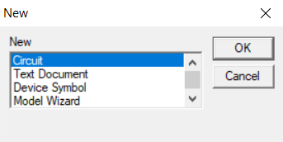
Follow along
Use file -> New -> Circuit -> OK to create a new empty circuit

Slide 42
Follow along
Use file -> New -> Circuit -> OK to create a new empty circuit

Slide 43
Follow along
Create the following circuit to test your VHDL
To create the breakouts, right click on the blue bus wires and click breakout
Use pin spacing of 4 for both breakouts

Slide 44
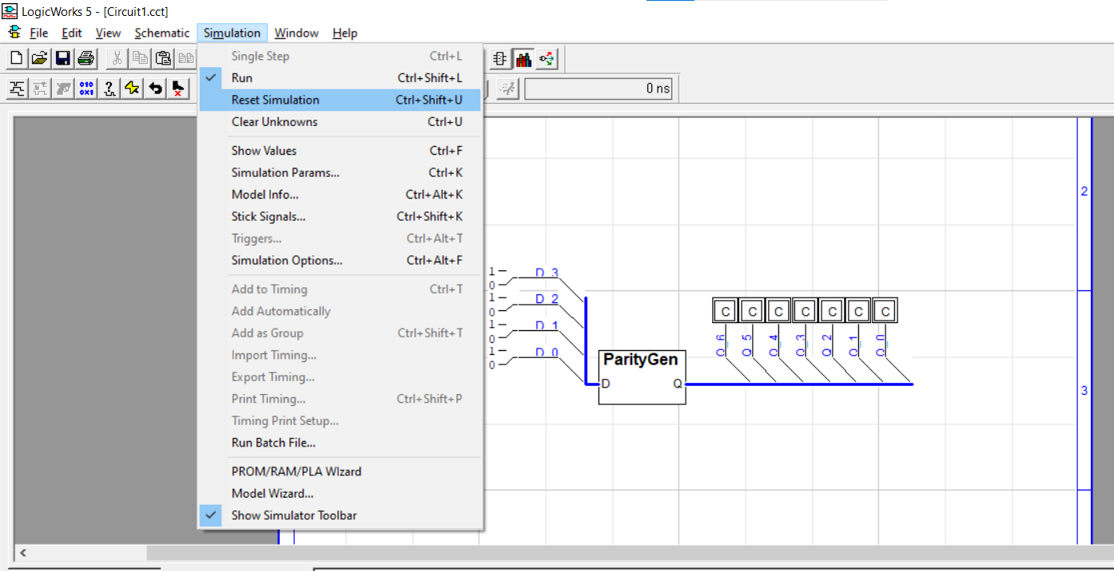
Follow along
Click Simulation -> reset simulation to clear the C values and test the VHDL component

Slide 45
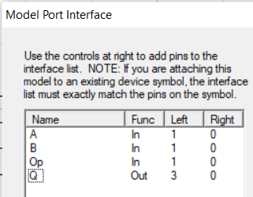
Follow along
Use the same process to create the ALU_2 part
Use the ports on this slide

Slide 46
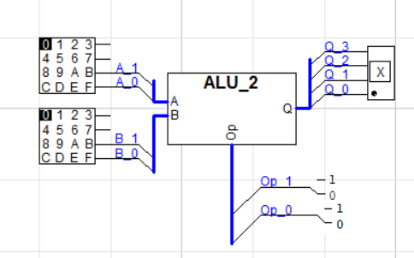
Follow along
Use the same process to create the ALU_2 part
Use the circuit layout on this slide

